Slide 1
UNIT 3
Activity Planning,
Risk Management
&
Resource Allocation

Slide 2
Chapter 1 Activity Planning

Slide 3
Introduction ?

Slide 4
Objectives of Activity Planning

Slide 5
When to Plan ?
Planning is an ongoing process of refinement, each iteration becoming more detailed and more accurate than last.
During Feasibility study
Main purpose to estimate
Timescales
Risk

Slide 6
Project time management

Slide 7
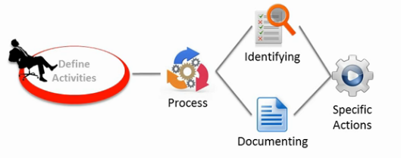
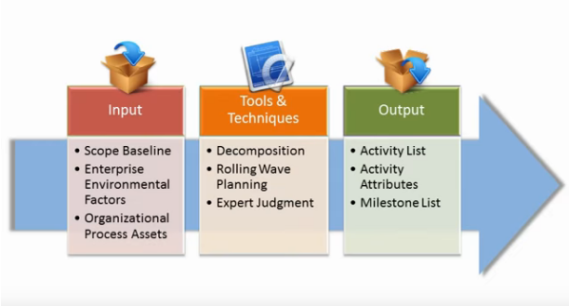
1. Define Activities

Slide 8
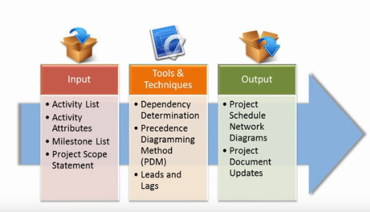
2. Sequence Activities

Slide 9
3. Estimate Activity Resources

Slide 10
4. Estimate Activity Duration

Slide 11
5. Develop Schedule

Slide 12
6. Control Schedule

Slide 13
Projects and Activities

Slide 14
Identifying Activities

Slide 15
1. Activity Based approach
Is creating a list of all activities
Require brainstorming session
Divide project into main life cycle and consider separately
Generating task list WBS
Is a structuring activites
Task catalogue-include task defination composed of non overlapping activities.
Higher level nodes - collection of activities

Slide 17
2. Product based approach
Producing a product breakdown structure (PBS) and product flow diagram (PFD)
PFD for each product
Transform Ordered list of activities
Use of methodology - SSADM or USDP
SSADM - reference manual provide generic PBSs
USDP - referred to as artifacts

Slide 18
3. Hybrid approach
Structuring a product Based or activity based might be influenced by the nature of project and particular method adopted
MITP methodology - IBM recommended five levels
Level 1 : project
Level 2 : deliverables
Level 3 : components
Level 4 : work packages
Level 5 : tasks

Slide 19
Sequencing and Scheduling Activities
We will require a schedule throughout a project
One way to present is bar chart
Chart drawn up taking account Of the nature of
the development process(certain task complete
before other May start) and resources are available.
Two things - sequenced the tasks and scheduled th tasks
For small project - sequenced-scheduling combined
For large project -sequenced -scheduling done
separately
Sequencing - logical relationship
Scheduling -resources

Slide 20
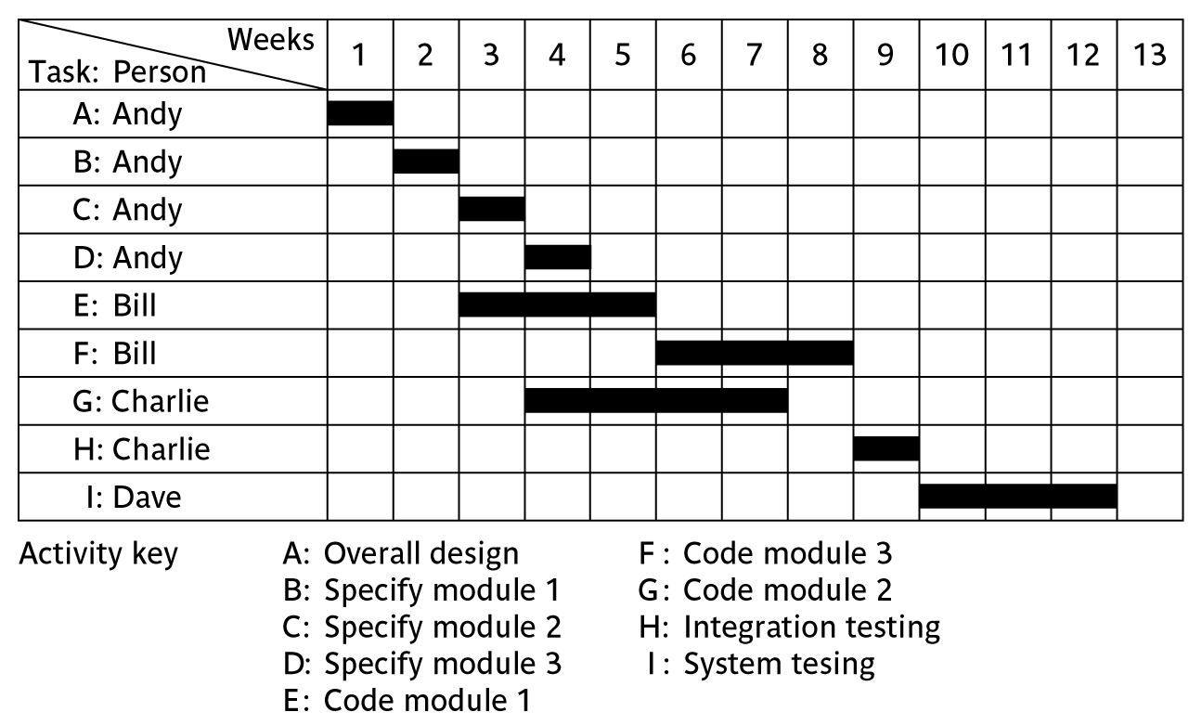

Slide 21
Network Planning models
Model project activities and their relationship as a network
In network- time flows from left to right
Techniques developed in 1950s - CPM and PERT
Both this techniques used an activity on arrow approach and activity on node

Slide 22
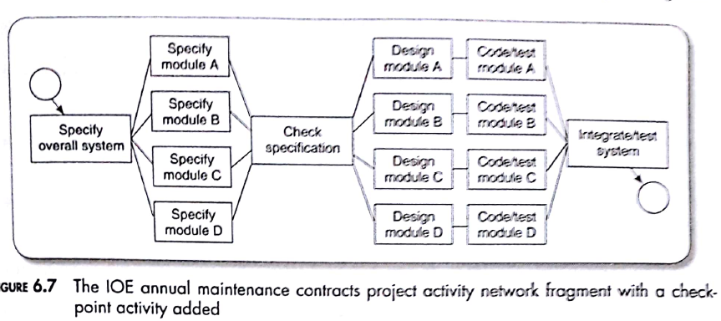
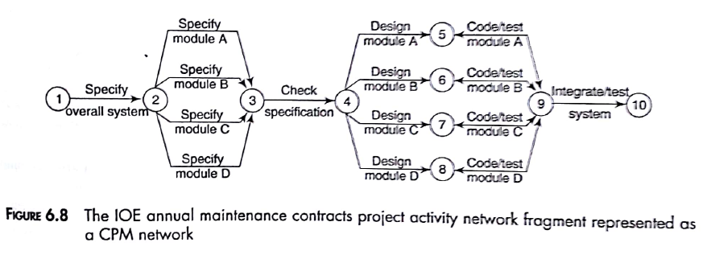

Slide 23
Formulating a network model
First stage is creating a modeI -represent activities and interrelationships as a graph.
Activity on node- nodes(boxes) ,lines shows dependencies

Slide 24
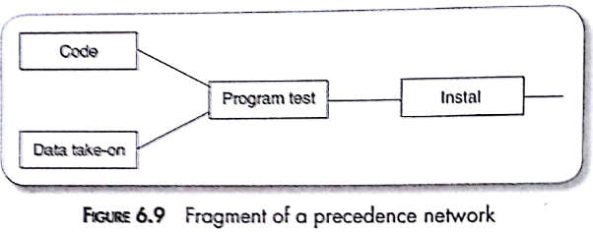
1. CONSTRUCTING PRECEDENCE NETWORKS
Rules for construction :
A project network -one start node -start activity with zero duration
A project network - one end node - -finish only once
A node has duration- activities take time to execute
Links have no duration - represent relationship
Precedents are the immediate proceeding activities

Slide 25
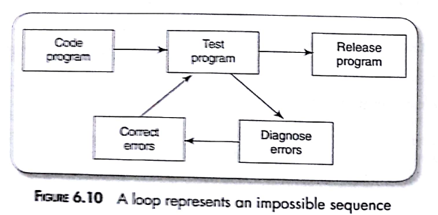
6. Time moves from left to right -
7. Network may not contain loops - while loops sense for iteration
8. A network should not contain dangles - activity is write users manual- indicate errors

Slide 27
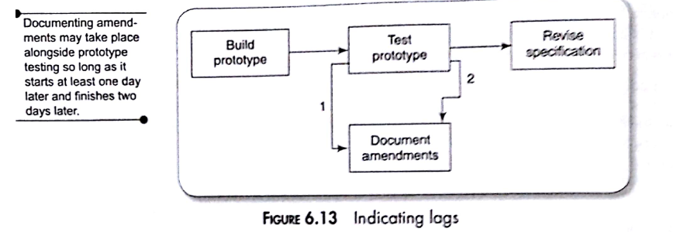
2. REPRESENTING LAGGED ACTIVITIES
Two activities in parallel so long as there is a lag between them
Lag with duration on linking arrow
Documenting amendments start one day after start of prototype

Slide 28
3. HAMMOCK ACTIVITIES
Themselves have zero duration - start at the same time as time as first "ham mocked" activity and end at same time
4 labelling conventions
British standard BS 4335
Uniquely identified
Test take on module

Slide 29
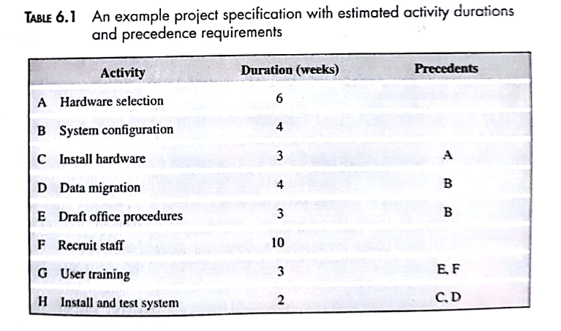
Adding time duration
Contain forward pass and backward pass

Slide 30
1. Forward pass

Slide 31
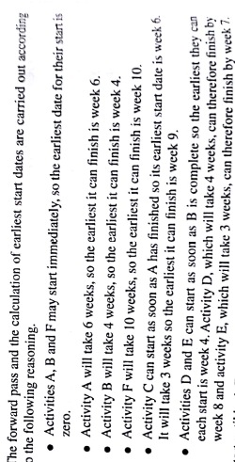
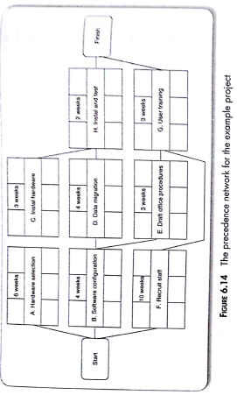
Carried out to calculate earliest date
Carried out using actual dates

Slide 32
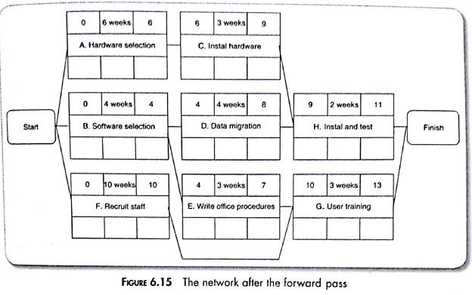

Slide 33
2. Backward pass

Slide 34
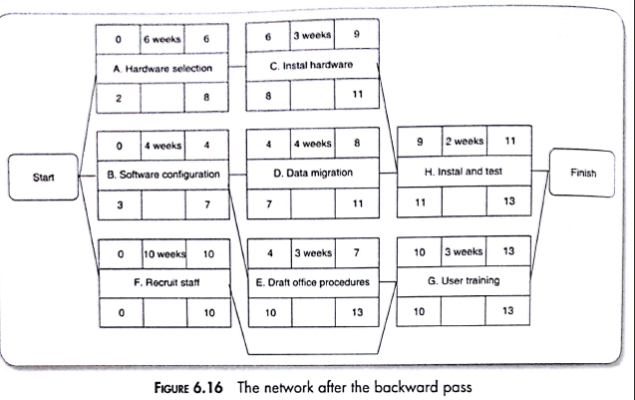
Calculate latest date.

Slide 35
Identifying criticaI path
Ant delay to any activity on critical path will delay completion of the project
Difference between earliest start date and latest start date vice versa finish date is known activity float
Float of zero-critical path

Slide 36
Activity Float
Belongs to the path to the network
Measures Of an Activity :
1. Free Float
Total Float is the amount of time that an activity can be delayed from its early start date without delaying the project finish date.
Free Float is the amount of time that an activity can be delayed without delaying the early start date of any successor activity.

Slide 37
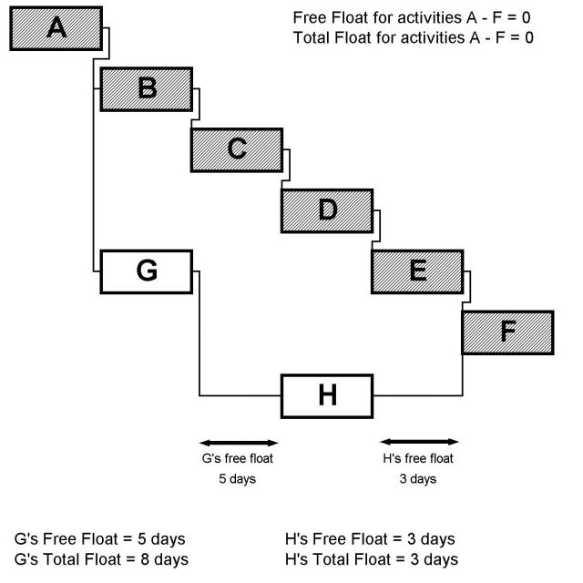

Slide 38
Interfering Float

